Slide 1


Improving character recognition of engraved/embossed steel type plates using GAN generated Image
Master’s Thesis Defense
Kalaiselvan Panneerselvam
Supervisors: Prof. Dr. Dr. Lars Schmidt-Thieme & Lukas Brinkmeyer
External supervisor : Thomas Kessler
August 18, 2020
Thesis Defense - Improving character recognition of engraved/embossed steel type plates using GAN generated Image 1/37

Slide 2

Overview
Introduction
Related works
Baselines & Approach
Dataset
Experiments
Results & Analysis
Conclusion
Thesis Defense - Improving character recognition of engraved/embossed steel type plates using GAN generated Image 2/37

Slide 3
1. Introduction
Genie Enterprise Inc, Ludwigshafen University of Hildesheim

Slide 4
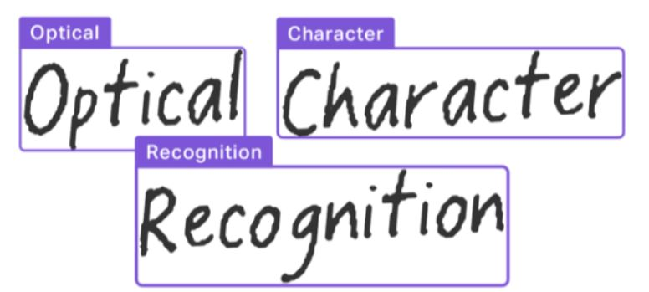
What is OCR?
Optical Character Recognition (OCR) is a set of computer vision tasks that convert scanned documents and images into machine-readable text.
The use case is to read text from the images of nameplates/type plates attached to power supply equipment.
Figure 1: OCR [Source: AI Compare 2020 ^{[11]}]
Supervisor:​ Mofassir ul Islam Arif University of Hildesheim, June 19th, 2019
Thesis Defense - Improving character recognition of engraved/embossed steel type plates using GAN generated Image 3/37

Slide 5
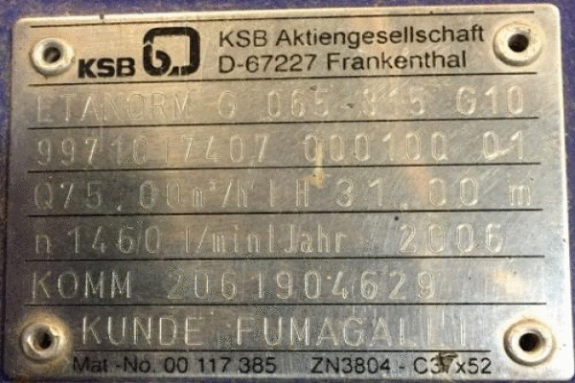
The problem statement
The steel type plates describe their equipment’s electrical
properties.
They are heavily weathered and stained.
Current practice is time consuming and susceptible to
typing errors.
Used Generative Adversarial Network (GAN) to address the
problem of poor character recognition.
Figure 2: Sample Images from the dataset
Supervisor:​ Mofassir ul Islam Arif University of Hildesheim, June 19th, 2019
Thesis Defense - Improving character recognition of engraved/embossed steel type plates using GAN generated Image 4/37

Slide 6
Research questions
Can an image-to-image translation GAN be used to improve the accuracy of character recognition for the images of weathered steel type plates?
Can the findings of Zhu et al. and Stoller et al. be used to make up for the few image pairs in the steel type plate dataset?
How to evaluate the three different image-to-image translation GAN models under the scope of the thesis and choose the optimal model for the proposed steel type plate recognition system?
How good is the proposed OCR engine compared to a commercial OCR tool like Google Vision? How can the performance of the overall framework be measured?
Supervisor:​ Mofassir ul Islam Arif University of Hildesheim, June 19th, 2019
Thesis Defense - Improving character recognition of engraved/embossed steel type plates using GAN generated Image 5/37

Slide 7
Contributions
Created a dataset of steel type plate images from scratch along with its label pairs.
A framework to generate synthetic data is introduced.
Investigated three different Image-to-Image translation GANs.
Explored different evaluation metrics such as SSIM, MSE, and FID for GAN.
Built the proposed OCR engine by integrating CRAFT text detection and text recognition model.
Compared the performance of proposed OCR engine against the Google vision OCR.
Supervisor:​ Mofassir ul Islam Arif University of Hildesheim, June 19th, 2019
Thesis Defense - Improving character recognition of engraved/embossed steel type plates using GAN generated Image 6/37

Slide 8
2. Related works
Genie Enterprise Inc, Ludwigshafen University of Hildesheim

Slide 9
Related works
The works of Aniket V et al. ^{[1]}, Wang Yu et al. ^{[2]}, Vilem et al. ^{[3]}, used different approaches to extract text from steel plates, metal surfaces, engine and chassis parts.
Raka and Agrawal ^{[12]} proposed an algorithm based on K - Nearest Neighbour (KNN) for reading embossed text from credit/debit cards.
Hu et al. ^{[24]} used CNN for enhancing the character recognition of embossed characters of the shoe soles.
Supervisor:​ Mofassir ul Islam Arif University of Hildesheim, June 19th, 2019
Thesis Defense - Improving character recognition of engraved/embossed steel type plates using GAN generated Image 7/37

Slide 10
Related works
The works of Karras et al ^{[14]}, Jin et al. ^{[15]} and Brock et al. ^{[16]} demonstrated the ability of GANs to generate realistic synthetic images of objects. Frid-Adar et al. ^{[20]} and Fiore et al. ^{[21]} used GANs as a data augmentation technique to increase the classification accuracy of CNNs.
Hosangadi et al. ^{[4]}, Lat & Jawahar ^{[26]} and Karimi et al. ^{[5]} used GANs for improving character recognition of documents using DCGAN, SRGAN and conditional GAN.
Supervisor:​ Mofassir ul Islam Arif University of Hildesheim, June 19th, 2019
Thesis Defense - Improving character recognition of engraved/embossed steel type plates using GAN generated Image 8/37

Slide 11
3. Baselines & Approach
Genie Enterprise Inc, Ludwigshafen University of Hildesheim

Slide 12
Baselines - GAN
Pix2pix GAN
Isola, Phillip et al. ^{[6]} proposed a method called pix2pix GAN which works pretty well in case of paired dataset.
CycleGAN
Zhu et al. ^{[7]} proposed CycleGAN for learning to translate an image from a source domain X to a target domain Y in the absence of paired examples.
FactorGAN
Stoller et al. ^{[8]} proposed FactorGAN to enable training generative models with incomplete observations.
Supervisor:​ Mofassir ul Islam Arif University of Hildesheim, June 19th, 2019
Thesis Defense - Improving character recognition of engraved/embossed steel type plates using GAN generated Image 9/37

Slide 13
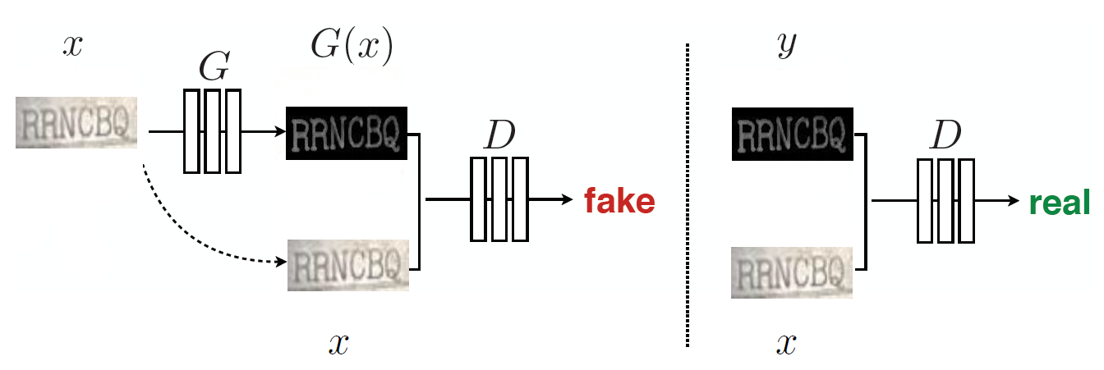
Pix2pix GAN
Figure 3: Training of pix2pix GAN. [Source: Adapted from Isola et al 2017 ^{[6]}]
Supervisor:​ Mofassir ul Islam Arif University of Hildesheim, June 19th, 2019
Thesis Defense - Improving character recognition of engraved/embossed steel type plates using GAN generated Image 10/37
Notes:
Pix2pix is a supervised image-to-image translation model that uses conditional GANs to learn a function to map input image to output image. It consists of two components i) Generator and ii) Discriminator similar to the standard GAN as shown in figure. The generator transforms the input image to the target domain while the discriminator measures the similarity of the input image to image passed randomly either by generator or the real image and predicts the probability of the image being real.

Slide 14
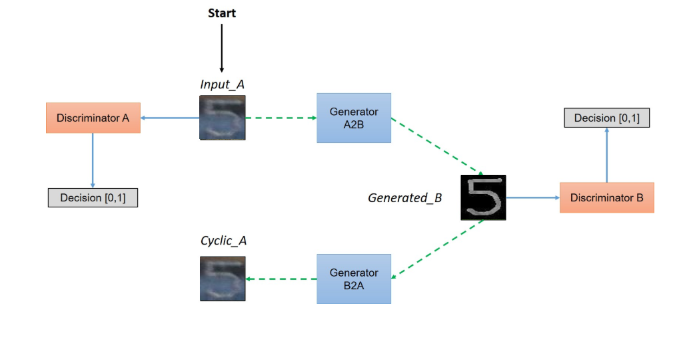
CycleGAN
Figure 7: Training of pix2pix GAN [Source : Adapted from Isola et al 2017 [6]]
Figure 4: CycleGAN. [Source: Adapted from Zhu et al 2018 ^{[7]}]
Supervisor:​ Mofassir ul Islam Arif University of Hildesheim, June 19th, 2019
Thesis Defense - Improving character recognition of engraved/embossed steel type plates using GAN generated Image 11/37
Notes:
CycleGAN is an unsupervised method for training image-to-image translation models. They learn the characteristics and styles from an image collection of source domain and translates it to the target domain in absence of paired data. The need for one to one mapping is eliminated by transforming the image from source domain to target domain and then back to the source domain just like translating a sentence from English to German and from German to English.

Slide 15
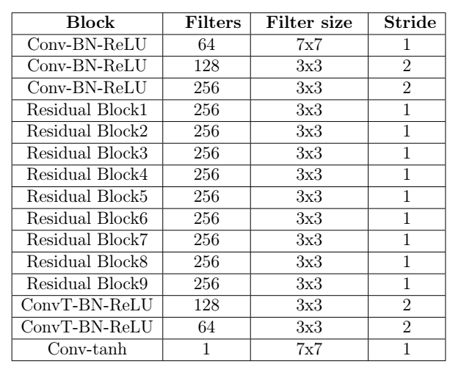
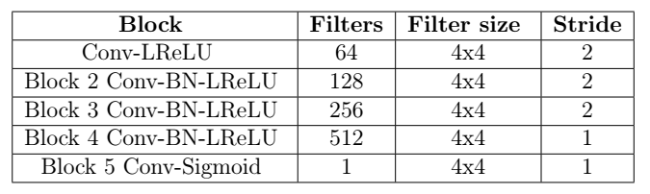
Pix2pix & Cycle GAN architecture
Table 2: Discriminator architecture
Table 1: Generator architecture
Supervisor:​ Mofassir ul Islam Arif University of Hildesheim, June 19th, 2019
Thesis Defense - Improving character recognition of engraved/embossed steel type plates using GAN generated Image 12/37

Slide 16
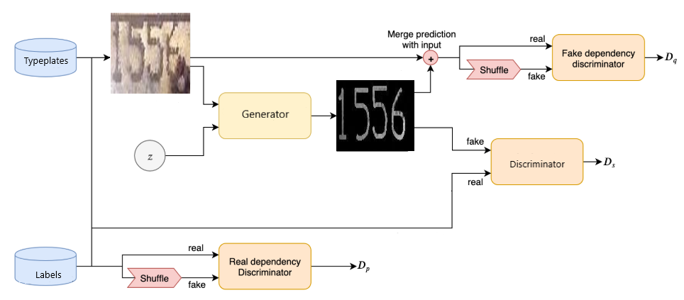
Factor GAN
Figure 5: Architecture of FactorGAN. [Source : Adapted from Stoller et al 2019 ^{[8]}]
Supervisor:​ Mofassir ul Islam Arif University of Hildesheim, June 19th, 2019
Thesis Defense - Improving character recognition of engraved/embossed steel type plates using GAN generated Image 13/37

Slide 17
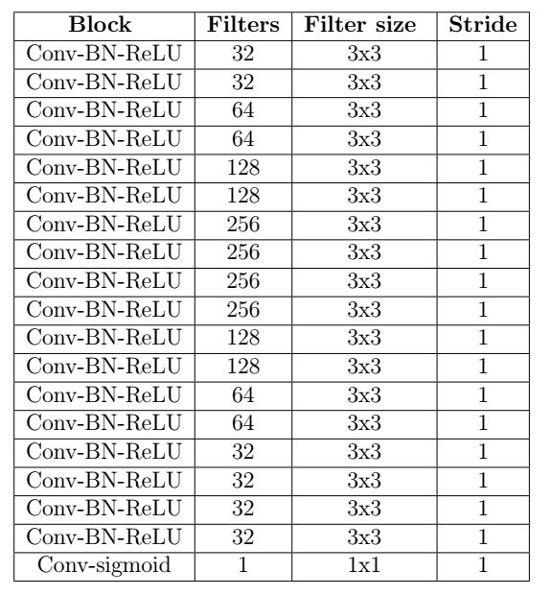
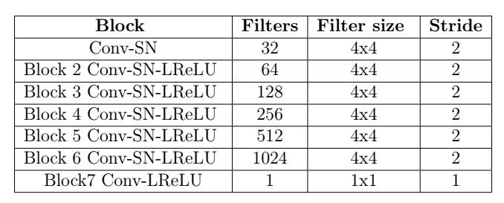
Factor GAN architecture
Table 4: Discriminator architecture
Table 3: Generator architecture
Supervisor:​ Mofassir ul Islam Arif University of Hildesheim, June 19th, 2019
Thesis Defense - Improving character recognition of engraved/embossed steel type plates using GAN generated Image 14/37

Slide 18
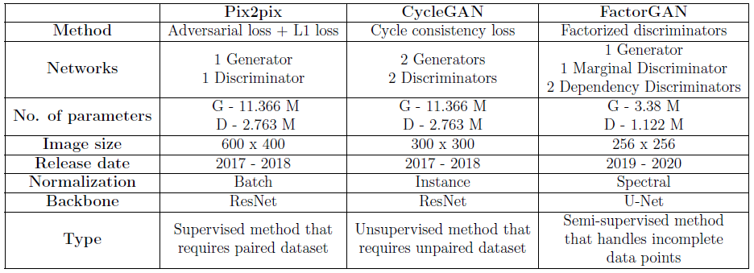
Comparison of GANs
Table 5: Comparison of image-to-image translation GANs under study
Supervisor:​ Mofassir ul Islam Arif University of Hildesheim, June 19th, 2019
Thesis Defense - Improving character recognition of engraved/embossed steel type plates using GAN generated Image 15/37

Slide 19
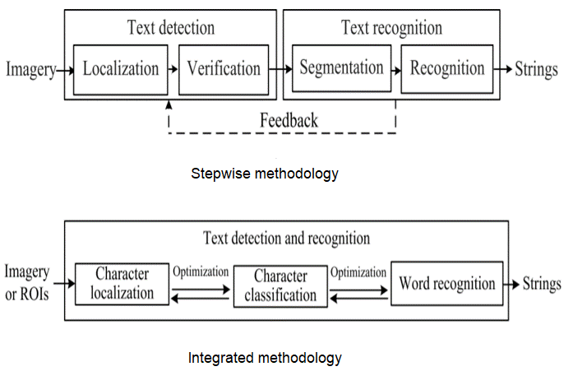
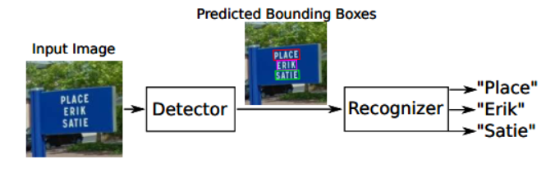
OCR methodology
Figure 6: Stages of OCR. [Source: Bartz et al. ^{[22]}]
Figure 7: Most commonly used OCR frameworks. [Source: Ye Q et al. ^{[23]}]
Supervisor:​ Mofassir ul Islam Arif University of Hildesheim, June 19th, 2019
Thesis Defense - Improving character recognition of engraved/embossed steel type plates using GAN generated Image 16/37

Slide 20
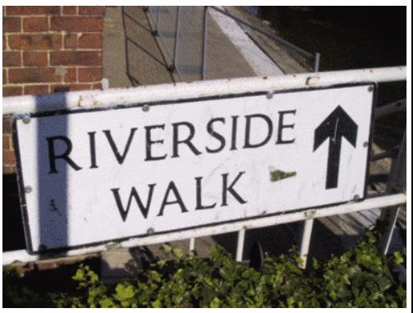
Text detection
CRAFT
Youngmin et al. ^{[9]} proposed method called Character-Region Awareness For Text detection that effectively detect text area by exploring each character region and affinity between characters.
Figure 8: Visualization of character-level detection using CRAFT. [Source: Youngmin et al 2019 ^{[9]}]
Supervisor:​ Mofassir ul Islam Arif University of Hildesheim, June 19th, 2019
Thesis Defense - Improving character recognition of engraved/embossed steel type plates using GAN generated Image 17/37

Slide 21
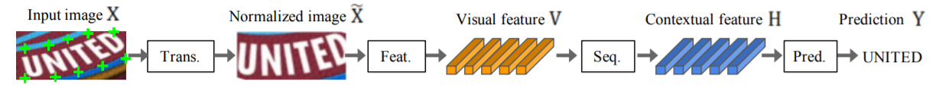
Text recognition
Baek et al. ^{[10]} in their work presented the fair comparison of different existing methods for scene text recognition.
An integrated framework that consists of four stages is proposed for scene text recognition.
Figure 9: Text Recognition framework. [Source: Baek et al 2019 ^{[10]}]
Supervisor:​ Mofassir ul Islam Arif University of Hildesheim, June 19th, 2019
Thesis Defense - Improving character recognition of engraved/embossed steel type plates using GAN generated Image 18/37

Slide 22
Google Vision OCR
Ready to use machine learning pre-trained models
REST API: receives images and resturns a JSON
$ 1.5 - $ 4.0 / 1000 units. Pay as you use model.
https://cloud.google.com/vision/
https://github.com/GoogleCloudPlatform/cloud-vision
Supervisor:​ Mofassir ul Islam Arif University of Hildesheim, June 19th, 2019
Thesis Defense - Improving character recognition of engraved/embossed steel type plates using GAN generated Image 19/37

Slide 23
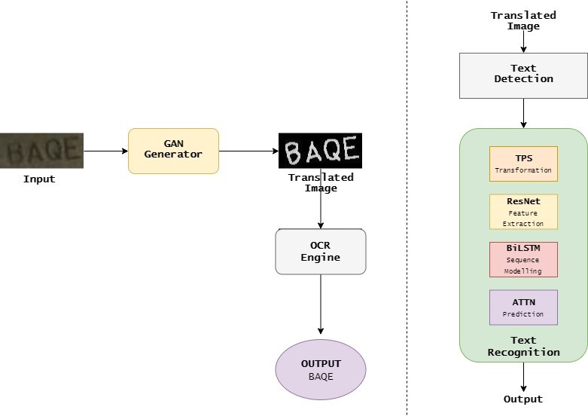
The overall framework
Figure 10: The overall framework and the proposed OCR engine
Supervisor:​ Mofassir ul Islam Arif University of Hildesheim, June 19th, 2019
Thesis Defense - Improving character recognition of engraved/embossed steel type plates using GAN generated Image 20/37

Slide 24
4. Dataset
Genie Enterprise Inc, Ludwigshafen University of Hildesheim

Slide 25
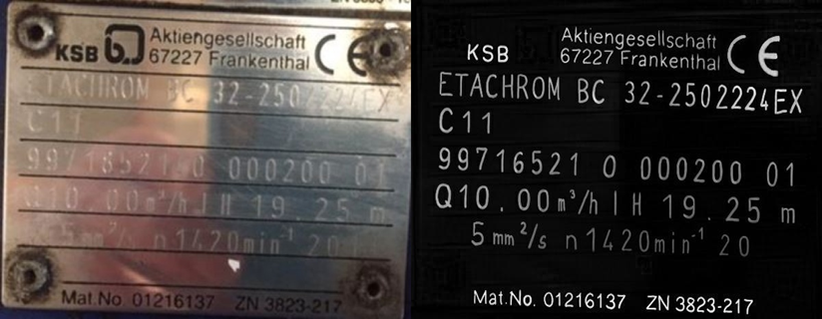
Datasets
Steel Type plates - ~ 400 image pairs.
Figure 11: A Steel type plate with input and its output pair
Supervisor:​ Mofassir ul Islam Arif University of Hildesheim, June 19th, 2019
Thesis Defense - Improving character recognition of engraved/embossed steel type plates using GAN generated Image 21/37

Slide 26
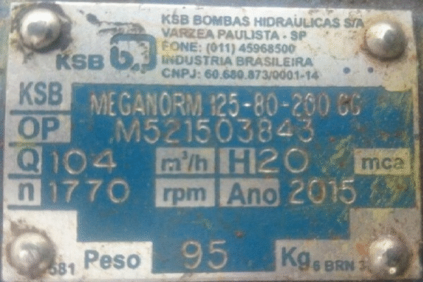
Preparation of data pairs
RGB
Grayscale
Annotated
Difference
Threshold
Figure 12: Image pair creation
Supervisor:​ Mofassir ul Islam Arif University of Hildesheim, June 19th, 2019
Thesis Defense - Improving character recognition of engraved/embossed steel type plates using GAN generated Image 22/37

Slide 27
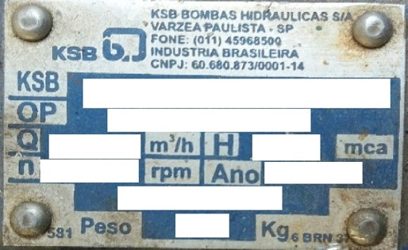
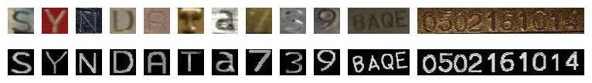
Creation of Synthetic data
Cropped patches of steel types.
More than 10 templates.
~ 750 image pairs with target labels.
Dictionary with different shapes of alphanumeric characters.
Figure 14: Steel type plate template
Figure 13: Samples in the dictionary pool
Supervisor:​ Mofassir ul Islam Arif University of Hildesheim, June 19th, 2019
Thesis Defense - Improving character recognition of engraved/embossed steel type plates using GAN generated Image 23/37

Slide 28
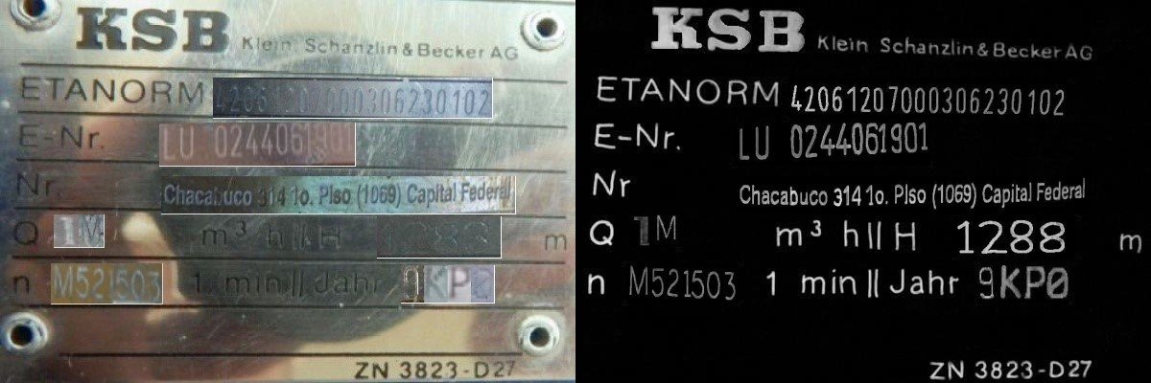
Synthetic data
Figure 15: Synthetic steel type plate image with its input and output pair
Supervisor:​ Mofassir ul Islam Arif University of Hildesheim, June 19th, 2019
Thesis Defense - Improving character recognition of engraved/embossed steel type plates using GAN generated Image 24/37

Slide 29
5. Experiments
Genie Enterprise Inc, Ludwigshafen University of Hildesheim

Slide 30
Hyperparameter Tuning
Normalization techniques (Batch/Instance)
Regularization in the form of dropout
Batch size with multi-GPU
Preprocessing the input image like crop, resize
Data augmentation
Varying Learning rate
Use of synthetic data
Supervisor:​ Mofassir ul Islam Arif University of Hildesheim, June 19th, 2019
Thesis Defense - Improving character recognition of engraved/embossed steel type plates using GAN generated Image 25/37

Slide 31
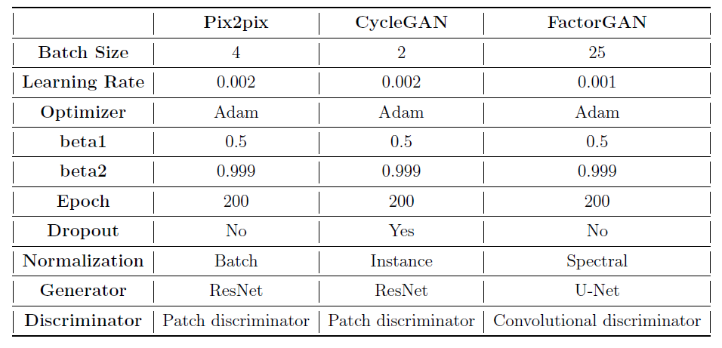
Best parameter settings
Table 6: Best parameter setting used in the experiments for each GAN
Supervisor:​ Mofassir ul Islam Arif University of Hildesheim, Oct 14th, 2019
Thesis Defense - Improving character recognition of engraved/embossed steel type plates using GAN generated Image 26/37

Slide 32
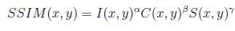
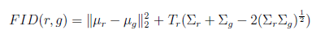
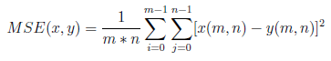
Evaluation metrics for GAN
1. Quantitative evaluation
a) SSIM: It is used to measure the similarity and quality of generated images with respect to the ground truth.
b) FID: a measure that classifies if the synthetic images are realistic with the help of a classification network trained on real images.
c) MSE: It calculates the average pixel difference between the ground truth images and the generated images.
2. Qualitative evaluation: Manual visual inspection of images is used as qualitative evaluation.
Supervisor:​ Mofassir ul Islam Arif University of Hildesheim, Oct 14th, 2019
Thesis Defense - Improving character recognition of engraved/embossed steel type plates using GAN generated Image 27/37

Slide 33
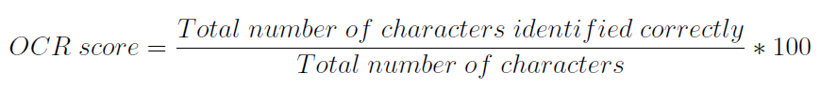
Evaluation metrics for OCR
Experimented with two different OCR engines:
1. Google Vision OCR
2. The proposed OCR
Each OCR engine has two outcomes: with GAN and without GAN.
The OCR score is given by the following formula:
Supervisor:​ Mofassir ul Islam Arif University of Hildesheim, June 19th, 2019
Thesis Defense - Improving character recognition of engraved/embossed steel type plates using GAN generated Image 28/37

Slide 34
6. Results & Analysis
Genie Enterprise Inc, Ludwigshafen University of Hildesheim

Slide 35
Qualitative Results
The manual image inspection is a good starting point for qualitative analysis.
The visual comparison of real and generated images is difficult when the changes are very small.
Used together with other evaluation metrics such that it complements quantitative evaluation.
Qualitative results
Supervisor:​ Mofassir ul Islam Arif University of Hildesheim, Oct 14th, 2019
Thesis Defense - Improving character recognition of engraved/embossed steel type plates using GAN generated Image 29/37

Slide 36
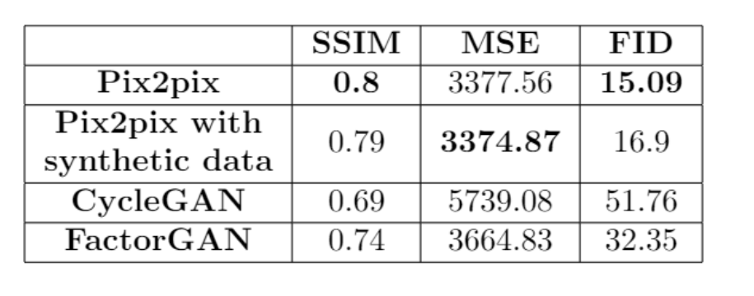
Quantitative Results
Table 7 : Quantitative results for GAN
Supervisor:​ Mofassir ul Islam Arif University of Hildesheim, Oct 14th, 2019
Thesis Defense - Improving character recognition of engraved/embossed steel type plates using GAN generated Image 30/37

Slide 37
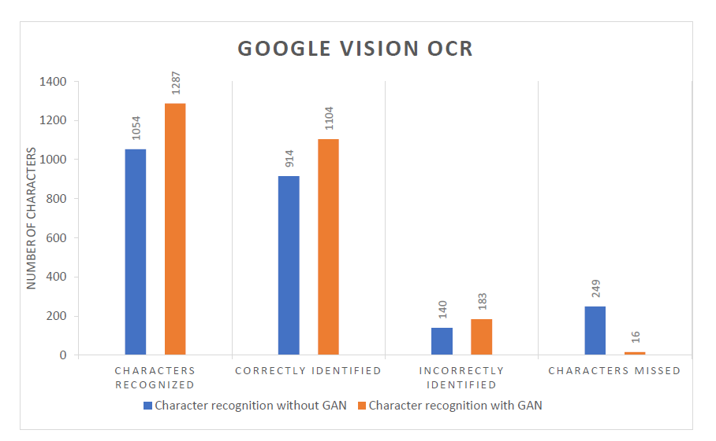
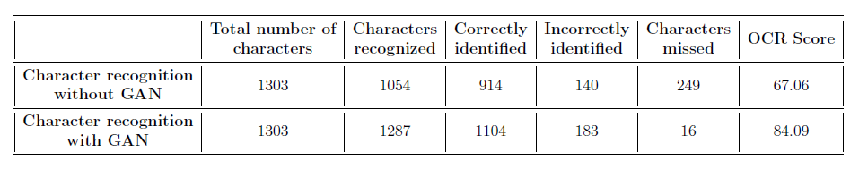
Evaluation using Google Vision OCR
Table 8: Character recognition with and without GAN using Google Vision OCR engine .
Figure 16: Evaluation using Google Vision OCR
Supervisor:​ Mofassir ul Islam Arif University of Hildesheim, Oct 14th, 2019
Thesis Defense - Improving character recognition of engraved/embossed steel type plates using GAN generated Image 31/37

Slide 38
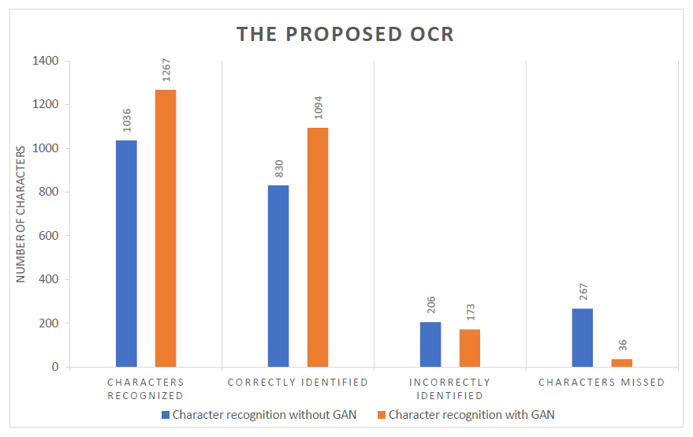
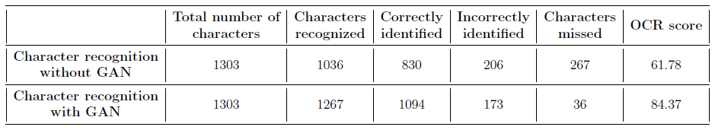
Evaluation using the proposed OCR
Table 9: Character recognition with and without GAN using proposed OCR engine .
Figure 17: Evaluation using the proposed OCR engine
Supervisor:​ Mofassir ul Islam Arif University of Hildesheim, Oct 14th, 2019
Thesis Defense - Improving character recognition of engraved/embossed steel type plates using GAN generated Image 32/37

Slide 39
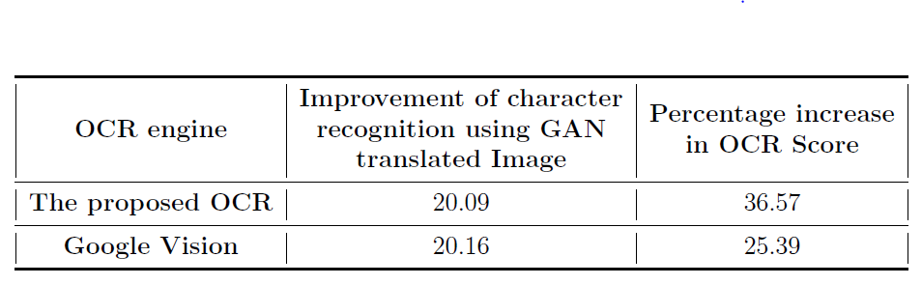
Comparison of impact of GAN on both OCR engines
Table 10: Comparison of impact of GAN on both OCR engines
Supervisor:​ Mofassir ul Islam Arif University of Hildesheim, Oct 14th, 2019
Thesis Defense - Improving character recognition of engraved/embossed steel type plates using GAN generated Image 33/37

Slide 40
7.Conclusion
Genie Enterprise Inc, Ludwigshafen University of Hildesheim

Slide 41
Answers to the research questions
1. Can an image-to-image translation GAN be used to improve the accuracy of character recognition for the images of weathered steel type plates?
Yes.
2. Can the findings of Zhu et al. and Stoller et al. be used to make up for the few image pairs in the steel type plate dataset?
No.
3. How to evaluate the three different image-to-image translation GAN models under the scope of the thesis and choose the optimal model for the proposed steel type plate recognition system?
MSE, FID and SSIM
4. How good is the proposed GAN engine compared to a commercial OCR tool like Google Vision? How can the performance of the overall framework be measured?
OCR Score
Supervisor:​ Mofassir ul Islam Arif University of Hildesheim, June 19th, 2019
Thesis Defense - Improving character recognition of engraved/embossed steel type plates using GAN generated Image 34/37

Slide 42
Insights
The pix2pix architecture worked very good compared to the other GAN baselines.
Embossed texts were not correctly transformed in most test cases.
Evaluation of the GAN results are tricky.
The model extracts text from unclear areas and improves character detection by 20% even for the benchmark OCR like Google Vision.
The proposed OCR stands out as the best OCR engine with a OCR score of 84.37%.
Thesis Defense - Improving character recognition of engraved/embossed steel type plates using GAN generated Image 35/37

Slide 43
Limitations
Availability of paired images.
Creation of new label pairs is costly.
The synthetic dataset is also limited by the number of samples present in the dictionary pool.
Labels lack uniformity and have a high human bias.
Thesis Defense - Improving character recognition of engraved/embossed steel type plates using GAN generated Image 36/37

Slide 44
Future works
Works such as Ming et al. ^{[19]} “Few-Shot Unsupervised Image-to-Image Translation” and Wang et al. ^{[25]} “Semi-supervised Learning for Few-shot Image-to-Image Translation” looks promising.
Loss functions can be the modified such that the model learns based on the output of the OCR engine directly as a combined loss instead of training image-to-image translation and OCR engine separately.
Thesis Defense - Improving character recognition of engraved/embossed steel type plates using GAN generated Image 37/37

Slide 45
References
[1] Patil, A.V.; Dhanvijay, M.M., “Engraved character recognition using computer vision to recognize engine and chassis numbers: Computer vision technique to identify engraved numbers”, in Proceedings of the 2015 International Conference on Information Processing, Pune, India, 16–19 December 2015.
[2] YU, WANG, et al. "An Engraving Character Recognition System Based on Machine Vision." DEStech Transactions on Computer Science and Engineering aiea (2017).
[3] Novák, P. Hurtík and H. Habiballa, "Recognition of distorted characters printed on metal using fuzzy logic methods," 2013 Joint IFSA World Congress and NAFIPS Annual Meeting (IFSA/NAFIPS), Edmonton, AB, 2013, pp. 733-738.
[4] Karimi, M., Veni, G., & Yu, Y. Y. (2020). Illegible Text to Readable Text: An Image-to-Image Transformation using Conditional Sliced Wasserstein Adversarial Networks. In Proceedings of the IEEE/CVF Conference on Computer Vision and Pattern Recognition Workshops (pp. 552-553).
[5] Hosangadi, R., Adiga, D., & Vyeth, V. (2019, October). OCR-friendly Image Synthesis using Generative Adversarial Networks. In Proceedings of the 2019 8th International Conference on Computing and Pattern Recognition (pp. 226-234).
[6] Isola, P., Zhu, J. Y., Zhou, T., & Efros, A. A. (2017). Image-to-image translation with conditional adversarial networks. In Proceedings of
the IEEE conference on computer vision and pattern recognition (pp. 1125-1134).
Thesis Defense - Improving character recognition of engraved/embossed steel type plates using GAN generated Image

Slide 46
References
[7] Zhu, J. Y., Park, T., Isola, P., & Efros, A. A. (2017). Unpaired image-to-image translation using cycle-consistent adversarial networks. In Proceedings of the IEEE international conference on computer vision (pp. 2223-2232).
[8] Stoller, D., Ewert, S., & Dixon, S. (2019). Training Generative Adversarial Networks from Incomplete Observations using Factorised Discriminators. arXiv preprint arXiv:1905.12660.
[9] Baek, Youngmin, et al. "Character Region Awareness for Text Detection." Proceedings of the IEEE Conference on Computer Vision and Pattern Recognition. 2019.
[10] Baek, J., Kim, G., Lee, J., Park, S., Han, D., Yun, S., ... & Lee, H. (2019). What is wrong with scene text recognition model comparisons? dataset and model analysis. In Proceedings of the IEEE International Conference on Computer Vision (pp. 4715-4723).
[11] AICompare (2020). Optical Character Recognition (OCR) : Which solution to choose?https://medium.com/@aicompare/optical-character-recognition-ocr-which-solution-to-choose-cd4f829c4e5
[12] Raka, P. and Agrawal, S. P. (2019). Ocr to read embossed text from credit/debit card.
[13] Bui, Q. A., Mollard, D., & Tabbone, S. (2017, November). Selecting automatically pre-processing methods to improve OCR performances. In 2017 14th IAPR International Conference on Document Analysis and Recognition (ICDAR) (Vol. 1, pp. 169-174). IEEE.
[14] Karras, T., Aila, T., Laine, S., & Lehtinen, J. (2017). Progressive growing of gans for improved quality, stability, and variation. arXiv
Thesis Defense - Improving character recognition of engraved/embossed steel type plates using GAN generated Image

Slide 47
References
preprint arXiv:1710.10196.
[15] Jin, Y., Zhang, J., Li, M., Tian, Y., Zhu, H., & Fang, Z. (2017). Towards the automatic anime characters creation with generative adversarial networks. arXiv preprint arXiv:1708.05509.
[16] Brock, A., Donahue, J., & Simonyan, K. (2018). Large scale gan training for high fidelity natural image synthesis. arXiv preprint arXiv:1809.11096.
[17] Wang, Z., Bovik, A. C., Sheikh, H. R., & Simoncelli, E. P. (2004). Image quality assessment: from error visibility to structural similarity. IEEE transactions on image processing, 13(4), 600-612.
[18] Heusel, M., Ramsauer, H., Unterthiner, T., Nessler, B., & Hochreiter, S. (2017). Gans trained by a two time-scale update rule converge to a local nash equilibrium. In Advances in neural information processing systems (pp. 6626-6637).
[19] Liu, M. Y., Huang, X., Mallya, A., Karras, T., Aila, T., Lehtinen, J., & Kautz, J. (2019). Few-shot unsupervised image-to-image translation. In Proceedings of the IEEE International Conference on Computer Vision (pp. 10551-10560).
[20] Frid-Adar, M., Diamant, I., Klang, E., Amitai, M., Goldberger, J., & Greenspan, H. (2018). GAN-based synthetic medical image
augmentation for increased CNN performance in liver lesion classification. Neurocomputing, 321, 321-331.
Thesis Defense - Improving character recognition of engraved/embossed steel type plates using GAN generated Image

Slide 48
References
[21] Fiore, U., De Santis, A., Perla, F., Zanetti, P., & Palmieri, F. (2019). Using generative adversarial networks for improving classification effectiveness in credit card fraud detection. Information Sciences, 479, 448-455.
[22] Bartz, C., Yang, H., & Meinel, C. (2017). STN-OCR: A single neural network for text detection and text recognition. arXiv preprint arXiv:1707.08831.
[23] Ye, Q., & Doermann, D. (2014). Text detection and recognition in imagery: A survey. IEEE transactions on pattern analysis and machine intelligence, 37(7), 1480-1500.
[24] Hu, W., Su, Y., & Li, J. (2019, October). Embossed Characters Enhancement Based on Convolutional Neural Network. In Proceedings of the 2019 International Conference on Artificial Intelligence and Advanced Manufacturing (pp. 1-5).
[25] Wang, Y., Khan, S., Gonzalez-Garcia, A., Weijer, J. V. D., & Khan, F. S. (2020). Semi-supervised Learning for Few-shot Image-to-Image Translation. In Proceedings of the IEEE/CVF Conference on Computer Vision and Pattern Recognition (pp. 4453-4462).
[26] Lat, A., & Jawahar, C. V. (2018, August). Enhancing ocr accuracy with super resolution. In 2018 24th International Conference on Pattern Recognition (ICPR) (pp. 3162-3167). IEEE.
Thesis Defense - Improving character recognition of engraved/embossed steel type plates using GAN generated Image

Slide 49
Thank you

Slide 50
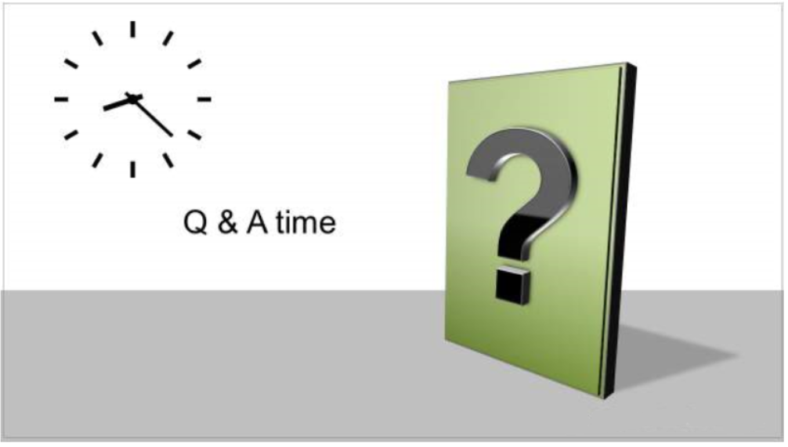

Slide 51
Out of distribution images
Tested the final model with images different from the ones used for traning.
Tod
BWresults

Slide 52
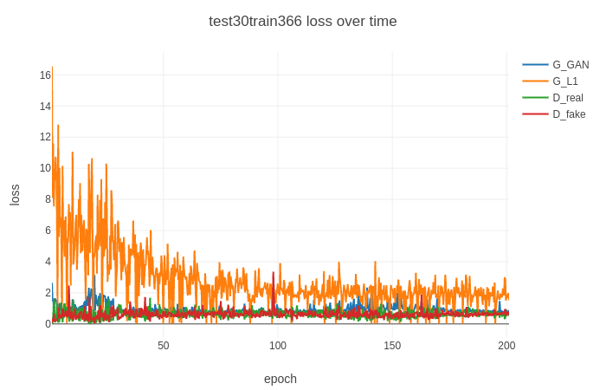

Slide 53
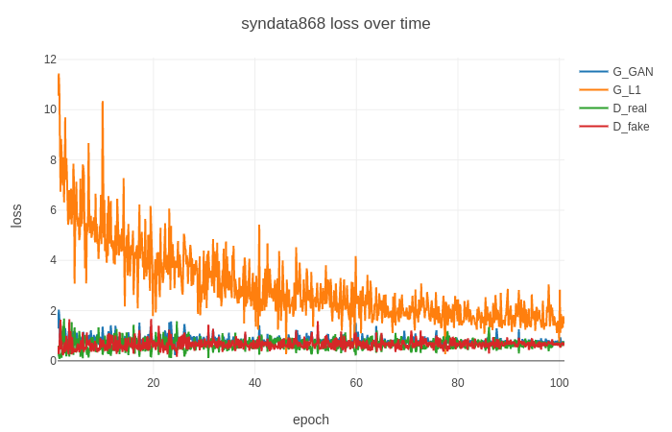

Slide 54
